Slide 1
Improving Power BI Q&A

Slide 2
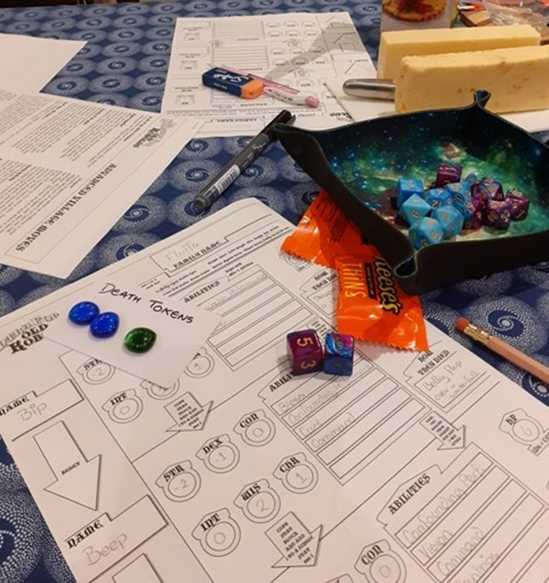
About Me - Laura
@Laura_GB
HatFullOfData.blog
HatFullOfData
Power BI Consultant

Slide 3



What is Q&A is not!

Slide 4



What is Q&A?
“The Q&A feature in Power BI lets you explore your data in your own words by using natural language.”

Slide 5

Demo

Slide 6

Quick Tips
Good table / column names
Add Synonyms
Review questions
If you meet a beholder – RUN!

Slide 7

Feedback
@Laura_GB
HatFullOfData.blog
HatFullOfData
Power BI Consultant
https://sqlb.it/?9695

Slide 8

You reach out and touch someone
+ 2
You roll
+ 5
And they heal that many HP
A flash of light
On failure and they fall over

